Slide 1
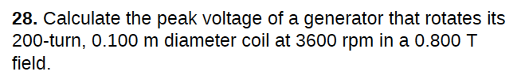








Slide 2
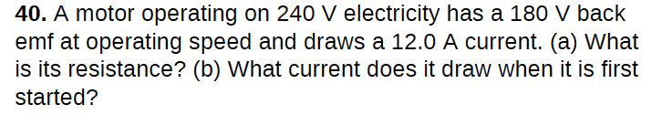




resistance:
current when starting:

Slide 3
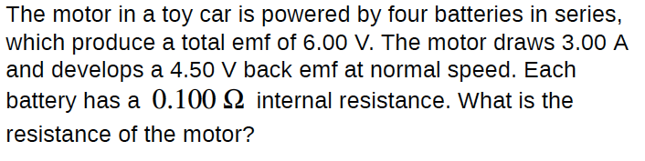











total internal resistance:

Slide 4





Slide 5






starting current:
operating current:

Slide 6

The efficiency of electric motor
Suppose the output toque of an electric motor is proportional to the current
and also proportional to the external load coefficient and angular speed.
$$τ=kΦI=aω$$
The back E.M.F is given by
$$ℰ=kΦω$$
The efficiency is defined as the ratio of the output mechanical power to the total electric power consumed by the motor.
$$η=\frac{P_{mech}}{IV}=\frac{IV−I^{2}R}{IV}$$
Please derive an expression of the efficiency, in terms of load coefficient a, internal resistance R and other characteristics of the motor.

Slide 7
$$I=\frac{V−ℰ}{R}=\frac{V−kΦω }{R}$$
$$τ=kΦI=aω$$
$$I=\frac{V}{R+\frac{k^{2}Φ^{2}}{a}}$$
$$η=\frac{IV−I^{2}R}{IV}=\frac{k^{2}Φ^{2}}{aR+k^{2}Φ^{2}}$$

Slide 8
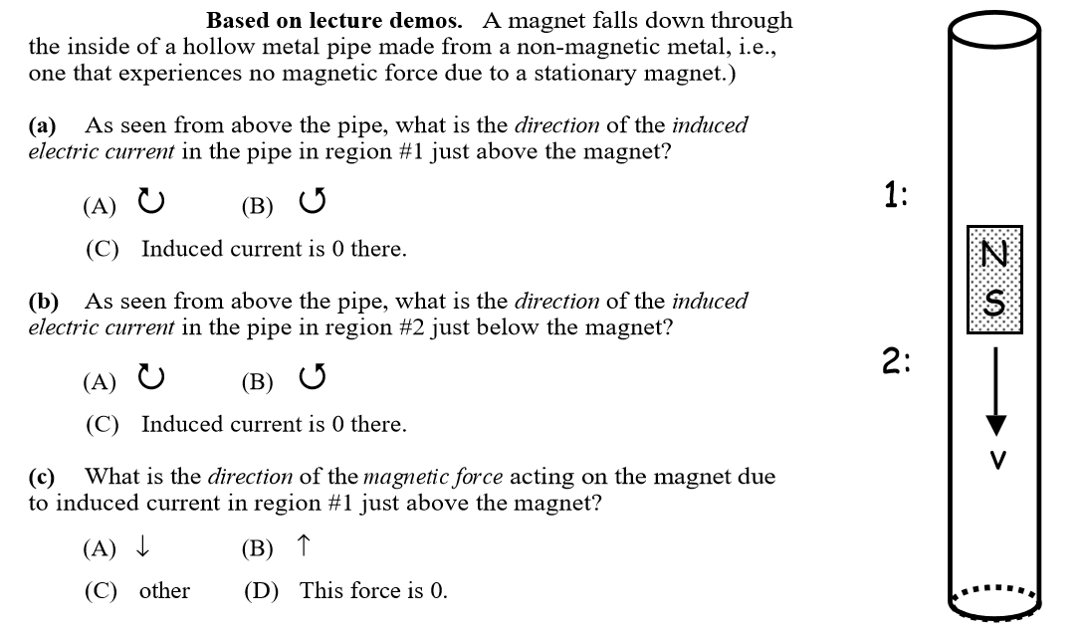
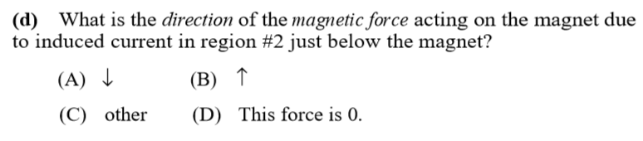

Slide 9
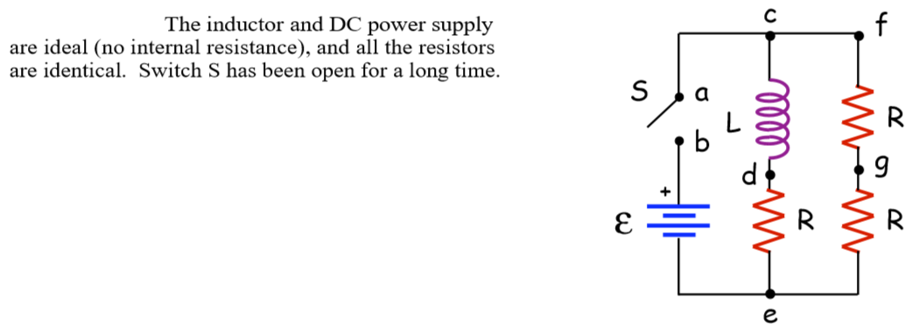
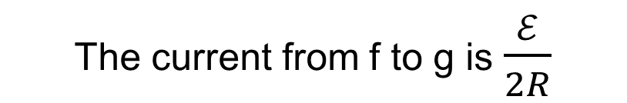
1, what is the current in the resistor between point f and g, a very short time after the switch is closed?
And what is the current in the battery at this time?
The current in the inductor is zero
The current from f to g is $\frac{ℰ}{2R}$
2, After a long time, open the switch again. What is the current in the resistor between point f and g, very soon after opening the switch? What is its direction?
Before opening the switch, the current in the inductor is $\frac{ℰ}{R}$
So right after opening the switch, the current is $\frac{ℰ}{R}$, from g to f
The induced EMF in the inductor is $3ℰ$

Slide 10
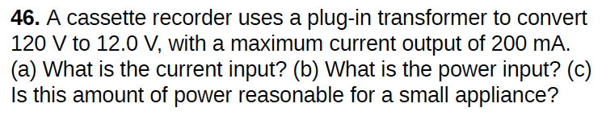
(a)
$$I_{1}=\frac{I_{2}V_{2}}{V_{1}}=\frac{200mA×12V}{120V}=20mA$$
$$I_{1}V_{1}=I_{2}V_{2}$$
(b)
Usually “120 V” is the rms value of ac voltage. If we regard 200 mA as rms value as well, then
$$P=I_{1}V_{1}=20mA×120V=2.4 W$$
If we consider 200 mA as the amplitude of current, we have
$$P=\frac{1}{\sqrt{2}}I_{1}V_{1}=\frac{1}{\sqrt{2}}×20mA×120V=1.7 W$$

Slide 11
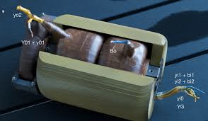






A portable x-ray unit has a step-up transformer, the 120 V input of which is transformed to the 100 kV output needed by the x-ray tube. The primary has 50 loops and draws a current of 10.00 A when in use.
(a) What is the number of loops in the secondary?
(b) Find the current output in the secondary?
!

Slide 12
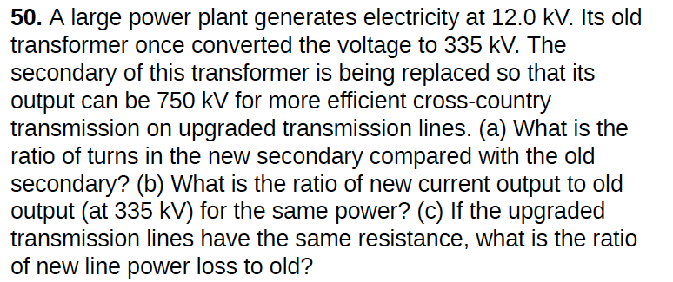
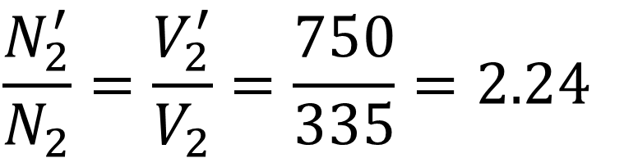
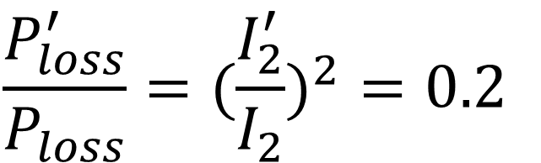
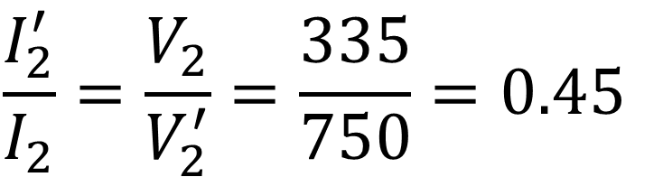
$$\frac{N_{2}^{′}}{N_{2}}=\frac{V_{2}^{′}}{V_{2}}=\frac{750}{335}=2.24$$
$$\frac{P_{loss}^{′}}{P_{loss}}=(\frac{I_{2}^{′}}{I_{2}})^{2}=0.2$$
(a)
(c)
$$\frac{I_{2}^{′}}{I_{2}}=\frac{V_{2}}{V_{2}^{′}}=\frac{335}{750}=0.45$$
(b)

